Slide 1
E-Week 2018
Arduino Tutorial
01/5/2018

Slide 2
Tutorial Goals
Servo Control
Arduino
Hardware
PC Setup
Software Overview
Library Intro
Basic Software Commands

Slide 3
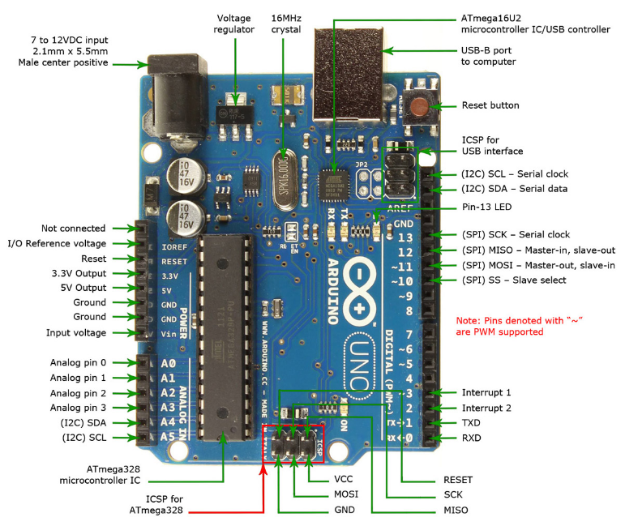
Arduino

Slide 4
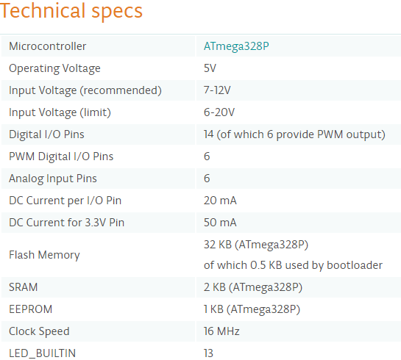
Arduino - Hardware

Slide 5
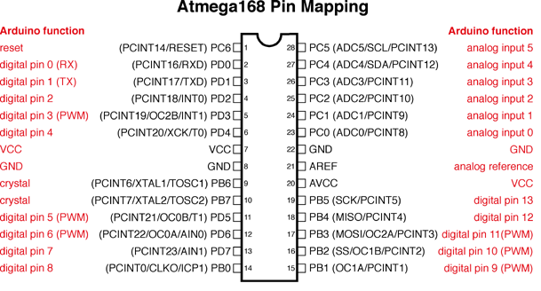
Arduino - Hardware
Supplying voltage via the 5V or 3.3V pins bypasses the regulator, and can damage your board. We don't advise it (but it works ☺)
I/O are 5Vdc, 20mA Max
LED: 13. There is a built-in LED driven by digital pin 13
6 analog inputs (A0-A5), 10 bits of resolution (i.e. 1024 different values). Measure from ground (0Vdc to 5Vdc)

Slide 6
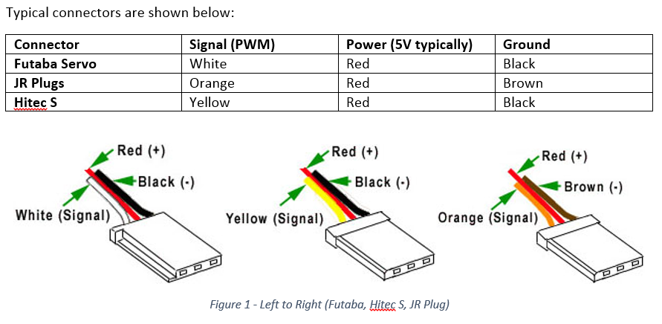
Servo Connectors

Slide 7
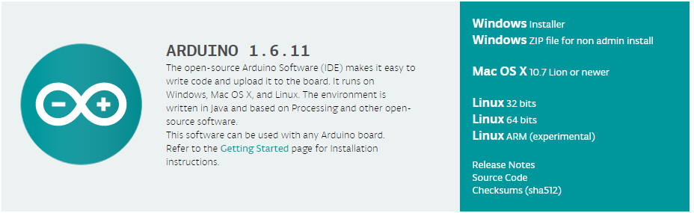
Arduino – PC Setup
Arduino Download Webpage

Slide 8
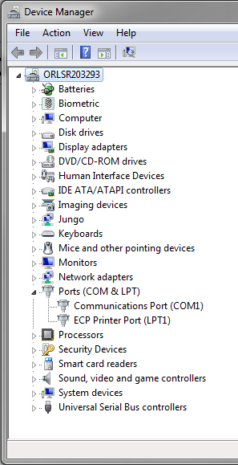
Arduino – PC Setup

Slide 9
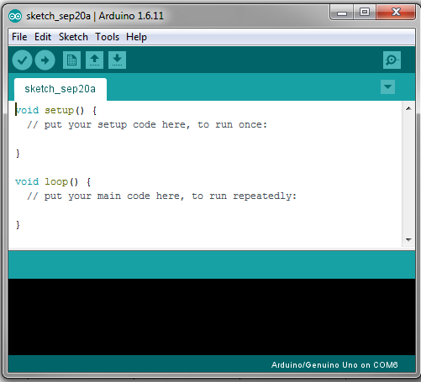
Arduino – Software Overview
File -> Examples
Sketch -> Verify/Compile (Compile Code)
Sketch -> Upload (Send SW to Arduino)
Sketch -> Include Library
Tools -> Board -> Arduino/Genuino Uno
Tools -> Port -> Port Assigned in Device Manager
Tools -> Serial Monitor (opens window to read/write serial data)

Slide 10
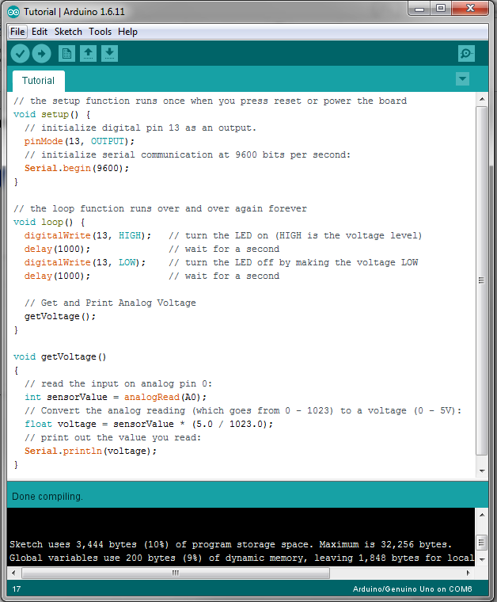
Arduino – Software Basics
setup
loop
pinMode
Serial.begin
Serial.println
digitalWrite
delay
int
float
https://www.arduino.cc/
Learning -> Reference

Slide 11
Resources
https://www.arduino.cc/en/Guide/Introduction
https://www.arduino.cc/en/Guide/ArduinoUno
https://www.arduino.cc/en/Guide/Libraries
https://www.arduino.cc/en/Tutorial/HomePage

